Slide 1
Advance Electronic I
THIRD YEAR
Lecturer: Abbas S.
Hameed
Main References:
1- Robert L. Boylestad and Louis Nashelsky, “ Circuit Theory “.
Electronic
Devices and
2- Thomas L. Floyd, “ Electronic
Devices. CCV “.
3- Adel S. Sedra and Kenneth Carless Smith, “ Microelectronic circuits “.

Slide 2
OPERATIOAL AMPLIFIER
Chapter Three Lect 9

Slide 3
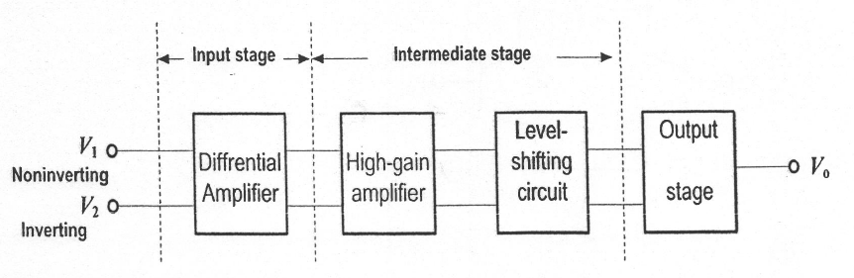
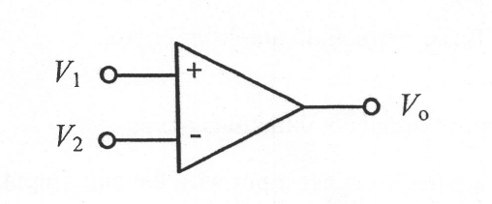
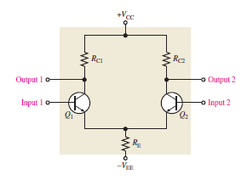

Slide 4
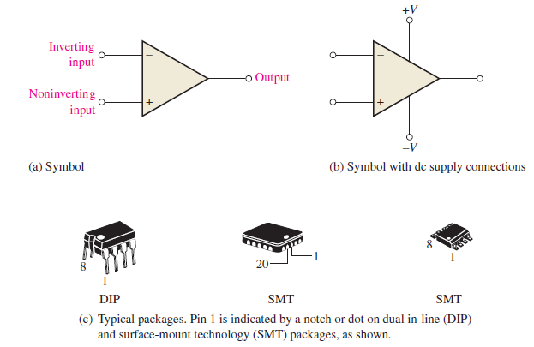

Slide 5
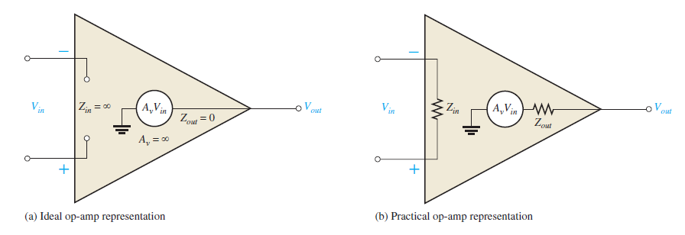

Slide 6
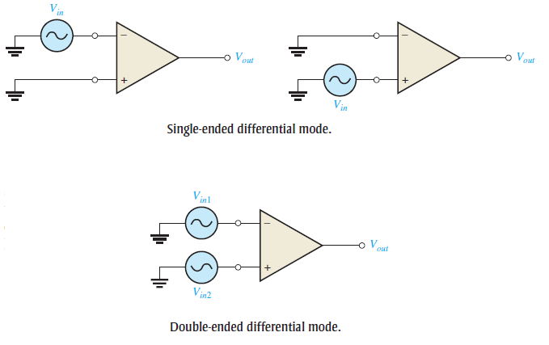
Input signal modes:

Slide 7
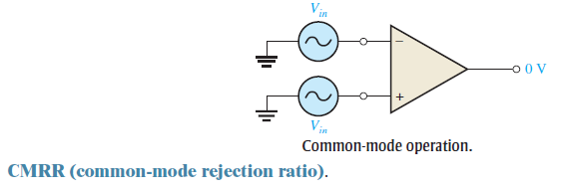
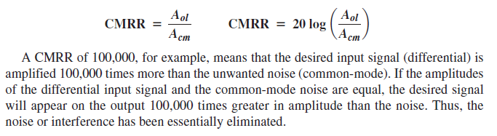

Slide 8
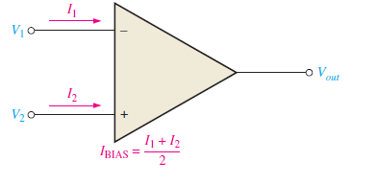
Maximum Output Voltage Swing (VO(p-p))
Input Offset Voltage
Input Bias Current

Slide 9
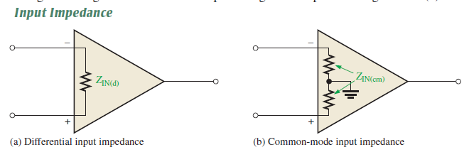

Slide 10
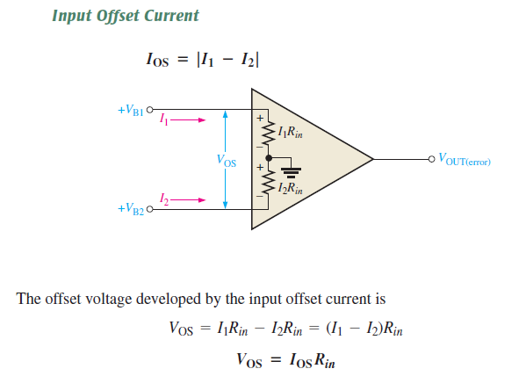


Slide 11
